Slide 1
Social Media Popularity
Arzoo Fatima
Caughey Key
Derrick Smith
Khatia Khokhiashvili
Natalia Perlaza

Slide 2
Background
Social media evolved significantly from niche platforms to essential daily tools (2009-2023).
They shape communication, culture, and commerce.
Social media are now a popular way to exchange information online.
New platforms emerge and old ones fade over time.
Two datasets: global and USA social media market share since 2009
Data was stored using SQL.

Slide 3
About Datasets
Worldwide dataset:
CSV format with several columns
First column: date (YYYY-MM)
Subsequent columns: market share percentages (rounded to 2 decimal places)
180 rows: 15 years of monthly data
USA dataset:
Similar format as worldwide dataset
178 rows: missing 3 columns (platforms) compared to global data

Slide 4
Overview
Chose Data Visualization Track and identified two datasets, stored in an SQL database.
Analyzed global and US social media trends through correlation analyses across platforms.
Explored the impact of new social media platforms on existing ones, and examined financial metrics of Facebook and Meta.
Studied growth trends in social media users over time and mean values across platforms.
Assessed market volatility of social media platforms and conducted a comparative analysis of WhatsApp/Messenger and Pinterest.

Slide 5
Overview
Investigated how social media platforms respond to global events and analyzed stock performance of Meta and Pinterest.
Insights aimed to guide strategic decisions on promotional strategies and investments in diverse sectors.
Developed SQL database, notebook, and webpage for showcasing data visualizations.
Implemented user interaction via HTML dropdown menus and JavaScript-powered visualizations.
Built Flask backend with interactive API routes to serve JavaScript-generated plots based on filtered data.

Slide 6
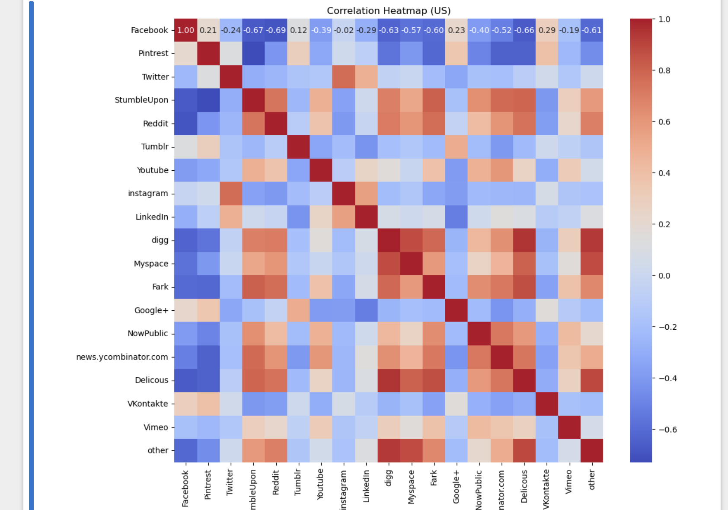
Correlation Analysis Between Platforms
Visualization: Heatmaps to show the correlation between the usage of different platforms.
Purpose: Understand how the usage of different platforms is related.

Slide 7
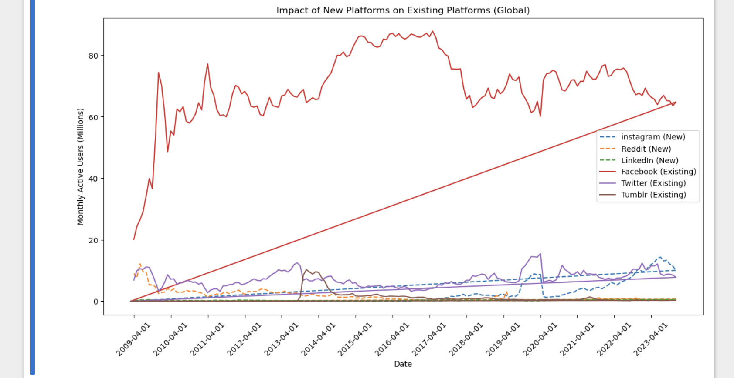
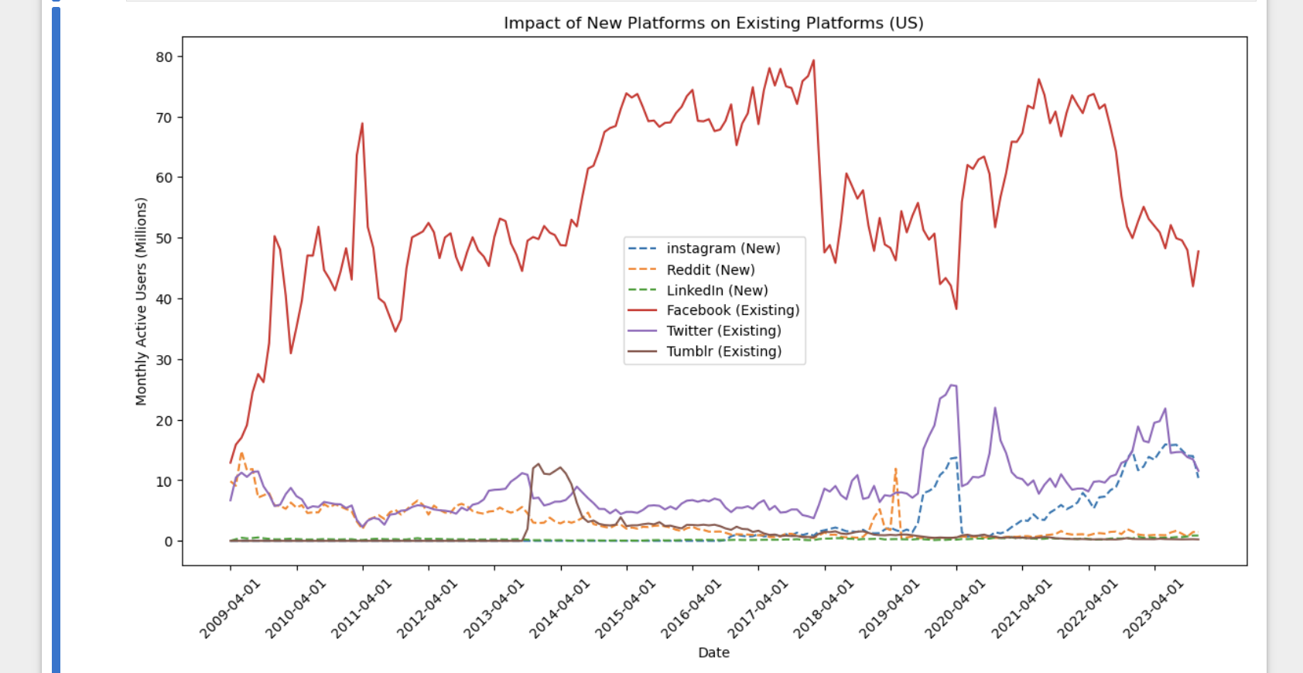
Impact of new platforms on Existing Platforms

Slide 8
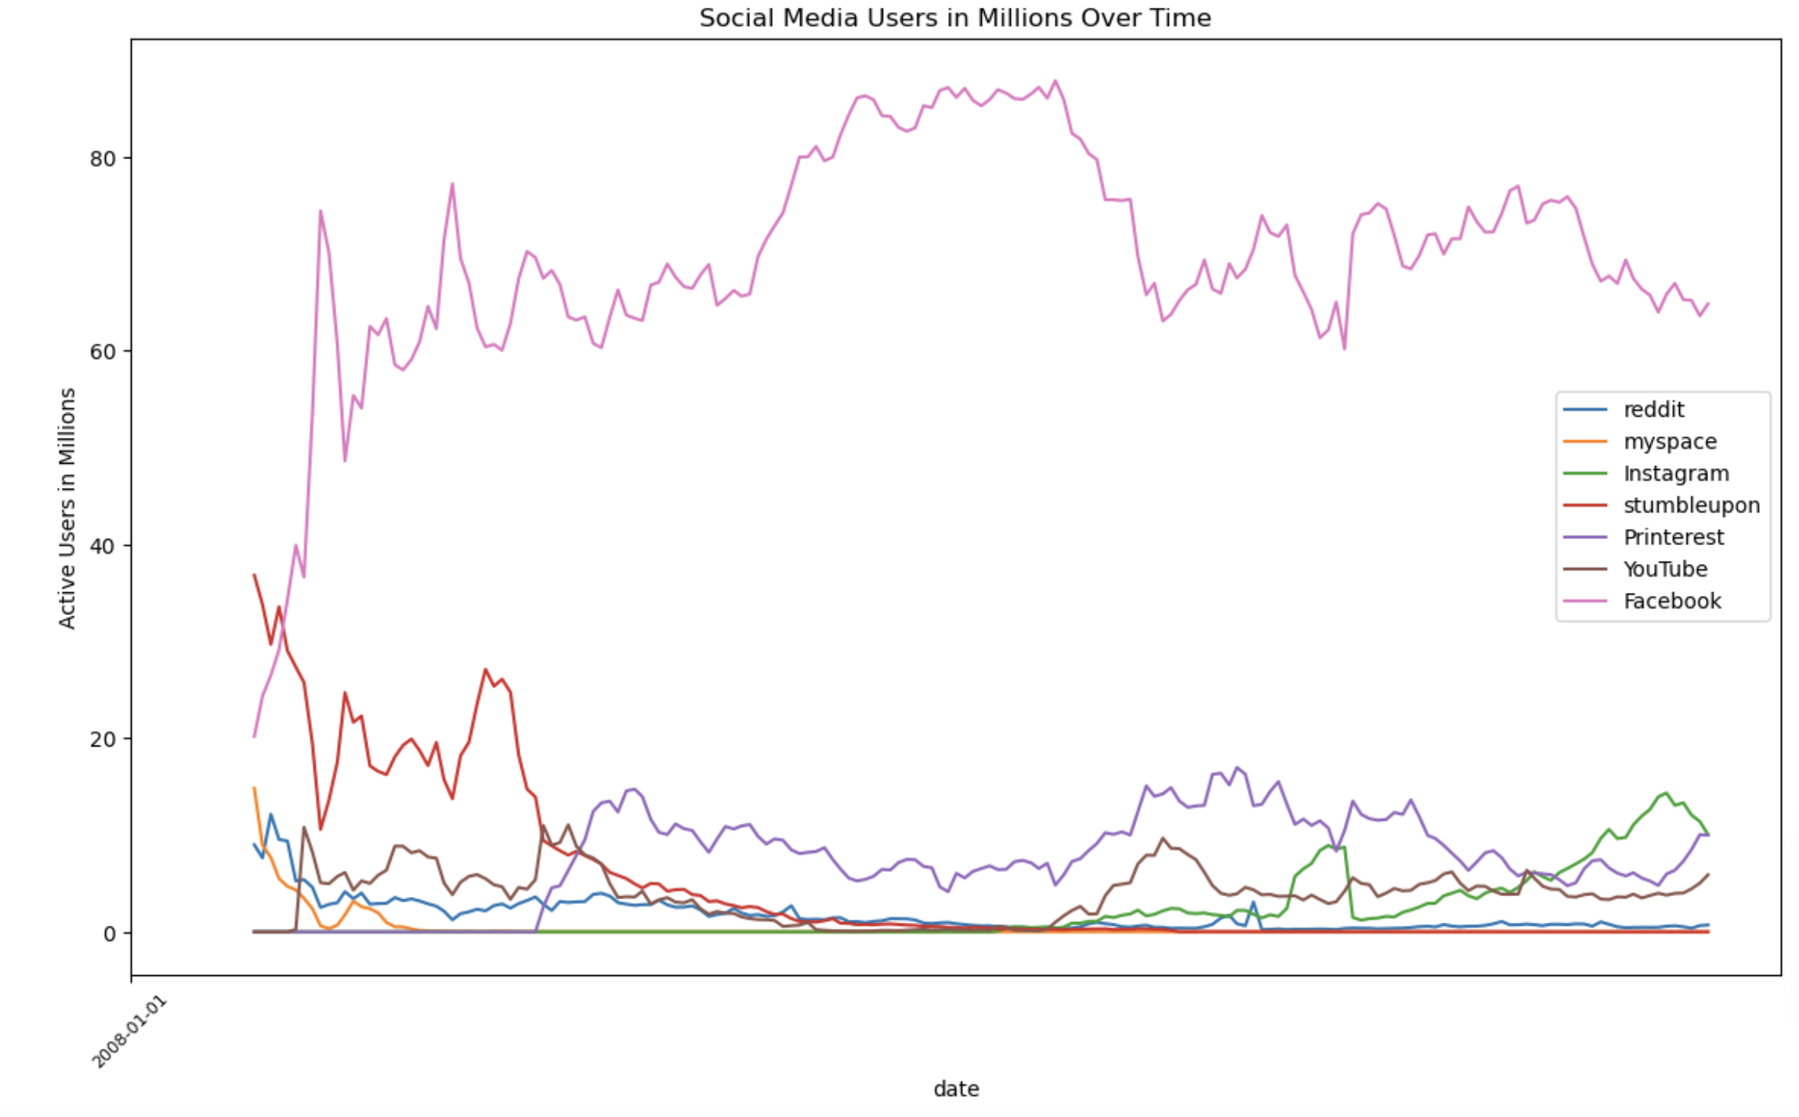
Social Media stats Worldwide (gs.statcounter.com)

Slide 9
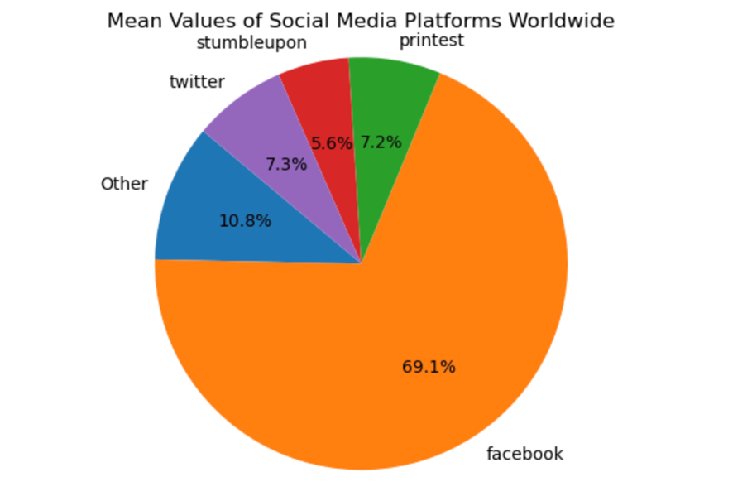
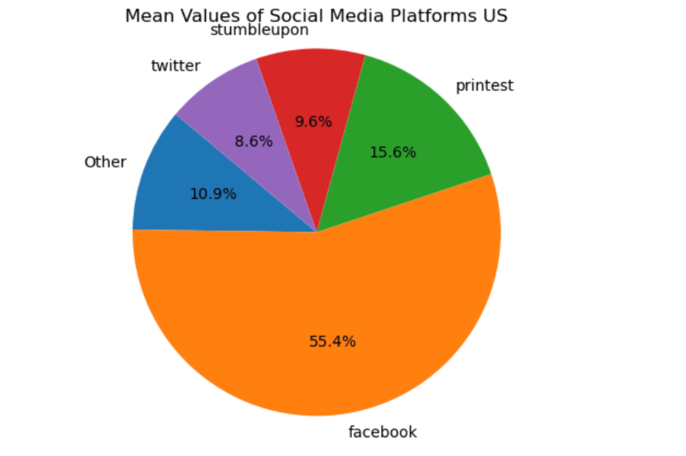
Mean Values of Social Media Platforms Worldwide and US

Slide 10
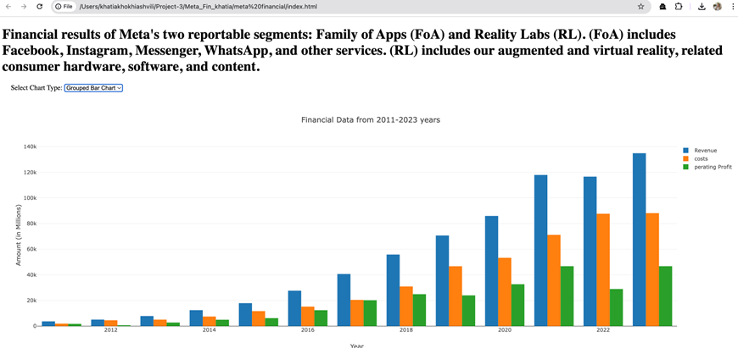
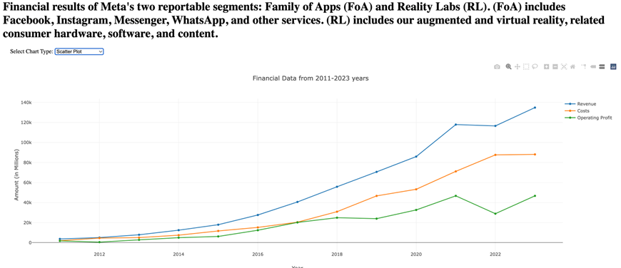
Financial results of Meta’s two reportable segment Family of Apps(Foa) and Rality Labs(RL)

Slide 11
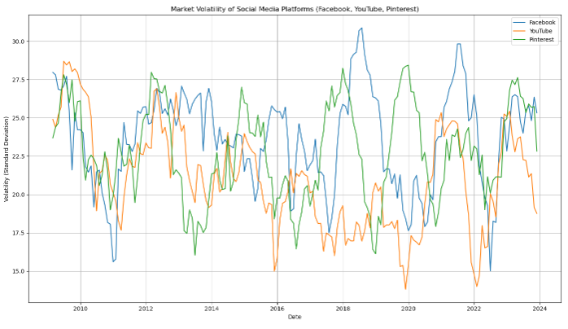
Market Volatility of Social Media Platforms
The market volatility graph depicts YouTube reaching its peak volatility of 27.5 in 2009, showcasing its resilience amid economic shifts. Facebook's volatility surged above 30 during its pivotal moments, reflecting its market sensitivity, while Pinterest hit its highest volatility peak in 2020 amidst global uncertainties, with all platforms currently stabilizing between 25 to 27.5.

Slide 12
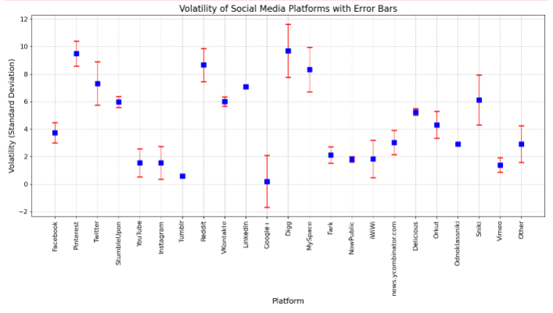
Market Volatility of Social Media Platforms

Slide 13
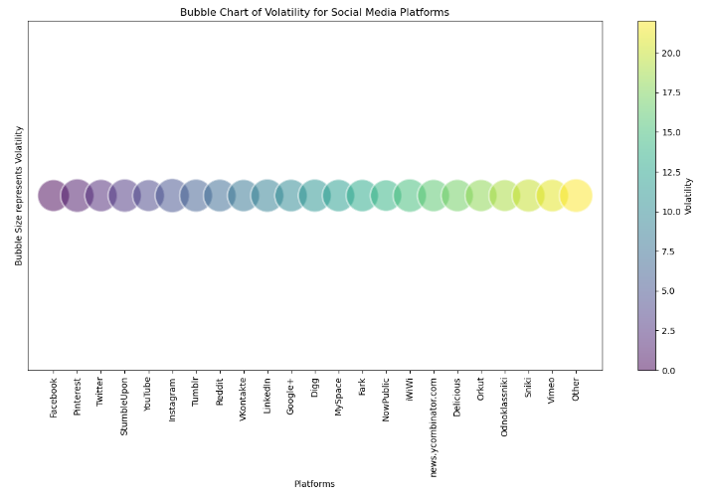
Market Volatility of Social Media Platforms

Slide 14
Comparative Analysis of WhatsApp/Messenger and Pinterest: Market Influence and Reaction to Global Events
Whatsapp, and messenger is one of the largest and most influential social media companies globally with over 5 billion monthly active users. Pinterest a independent company stills holds a solid market share , ranking as a third tier company with 450 million monthly active users . Both companies show similar stock movement in reaction to major global events, in 2020 COVID and in 2022 Ukraine war combined with supply issues and US economic downturn

Slide 15
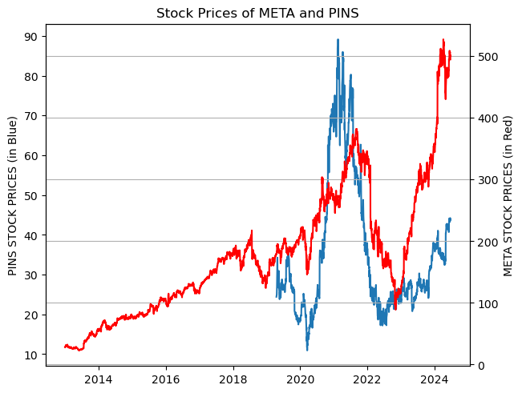
Stock Prices of META and PINS
Chart compares the two with pinterests stock prices on the left y axis and meta stock prices on the right y axis , so the similarity between the two con be easily seen , and the second chart shows the comparison with just using meta stock range showing a vast stock difference

Slide 16
Ethical Considerations
All data used in this project is publicly available and properly cited.
Sensitive information has been anonymized to respect user privacy.
The visualizations are designed to present data ethically and responsibly.

Slide 17
Conclusion
Analyzed global social media trends, usage patterns, volatility, market values, and competitive landscape from 2009 to 2023.
Utilized charts, graphs, and visualizations to demonstrate social media's deep integration into modern society.
Insights could inform strategic decisions for promotional strategies and investments across various sectors.
Dataset enables proactive monitoring to safeguard against social and economic vulnerabilities.

Slide 18
Resources
Kaggle https://www.kaggle.com/datasets/michau96/social-media-popularity-2009-2023
Statcounter https://gs.statcounter.com/
Yahoo Finance
Google Trends Data: [Google Trends](https://trends.google.com/trends/)
Dataset and Methodology details available upon request.

